Slide 1
Fitts’ law
By
Group 3
S. Amulya (19K41A04B6)
P. Rithika Reddy (19K41A05A8)
S. Shiva Keerthi (19K41A05B1)
K. Srilatha (19K41A05A2)
T. Vinuthna (19K41A05B5)
Under the guidance of
Mr. Rajashekhar P.V
Assistant Professor, Department of CCC

Slide 2
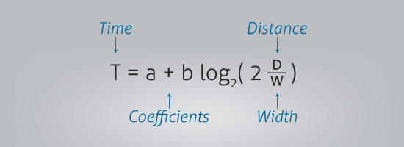
Fitts’ law
Fitts’ law states that the amount of time required for a person to move a pointer to a target area is a function of the distance to the target divided by the size of the target.
Thus, the longer the distance and the smaller the target’s size, the longer it takes.

Slide 3
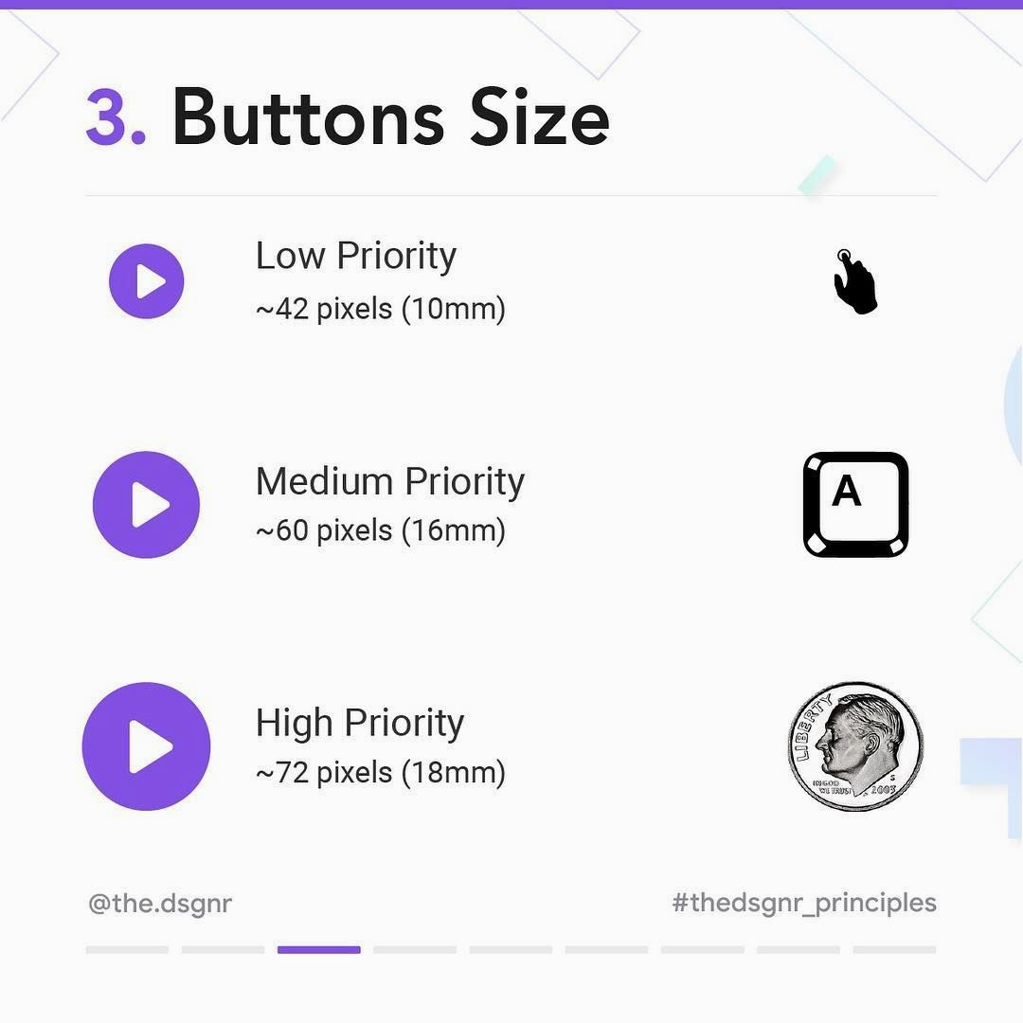
Fitts’ Law in User Interface
1. Size of Buttons

Slide 4
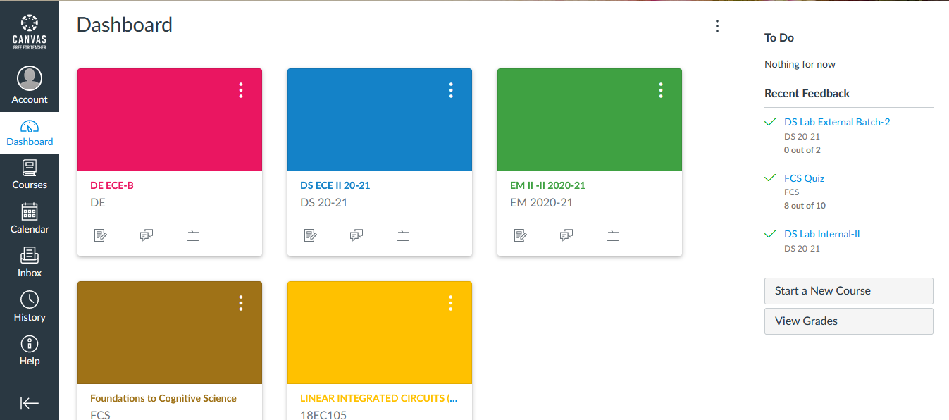
2. Layout

Slide 5
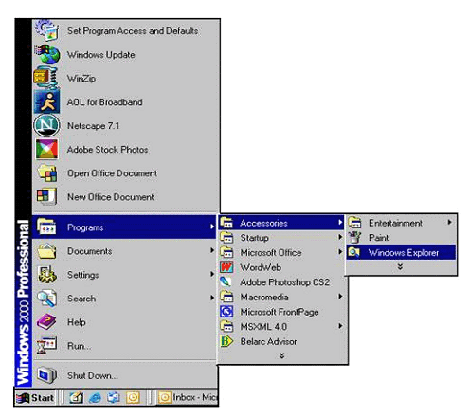
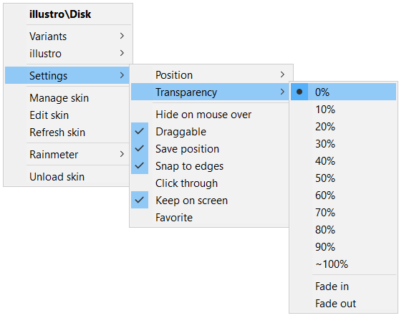
3. Menu

Slide 6

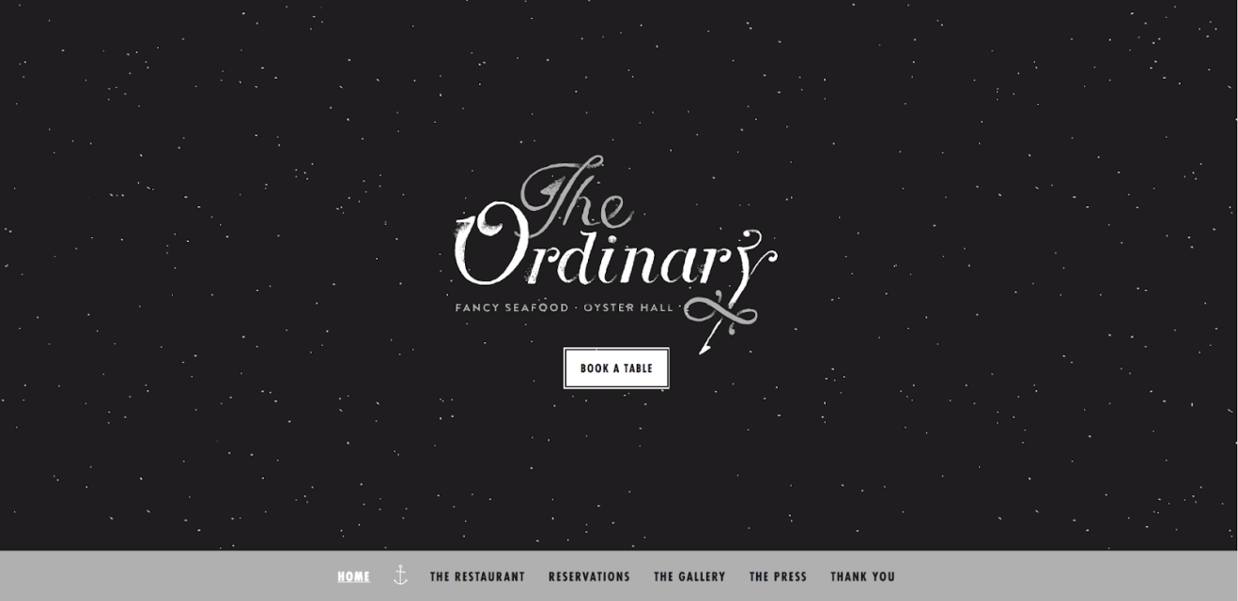
4. Color Contrast

Slide 7
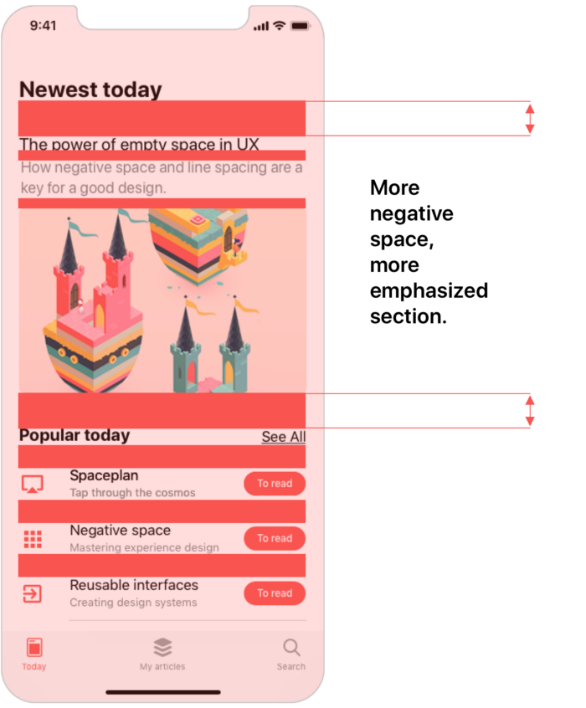
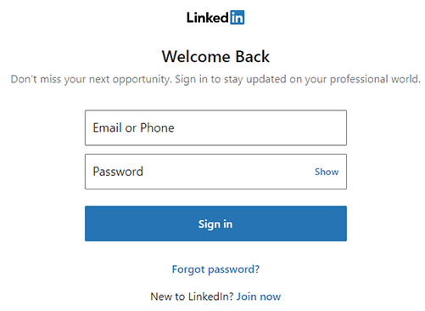
5. Spacing

Slide 8

6. Similarity

Slide 9
The Fitts’ law experiment
Aim
The aim of this experiment is to study Fitts’ law and to compare the experimental results/data of youngsters and adults.

Slide 10
Objectives
In this experiment, we try to compare and contrast the attention, perception and quicker reflexes of both groups.
The results of this experiment can be used to create specialized user interface designs for target customers of different age groups.

Slide 11
Participants
We gathered 14 people for the experiment out of which 7 people were of the age group 20-23 years and 7 others are 40-46 years old.
We particularly chose the participants from these age groups to compare the Fitts’ law resultant data of youngsters and adults.

Slide 12
PsyToolKit Website
The participants took the experiments through the PsyToolKit Fitts’ law demo version.
This website is frequently used for academic studies, student projects and for teaching cognitive and personality psychology.

Slide 13
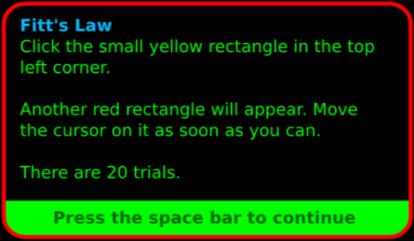

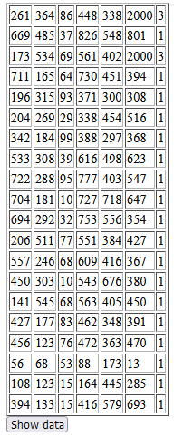
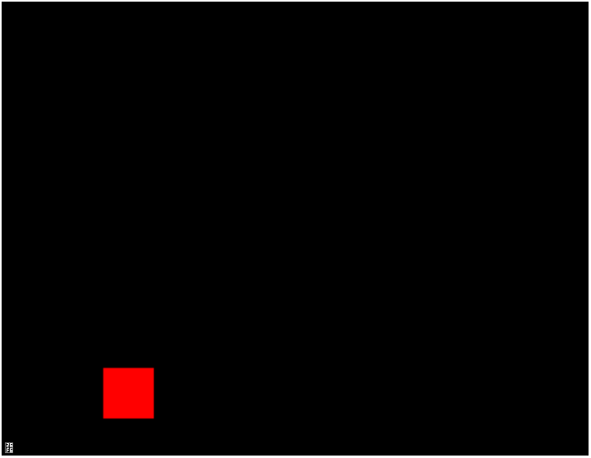
Rules

Slide 14

Analyzing the data
To compare the data, we have mainly considered two parameters: size and distance.
We picked out the smallest as well as largest stimulus in size and distance to make 2 separate tables which helps us to analyze the results.
In each table, we compare the participant’s Fitts’ expected time with experimentally obtained time to calculate the error percentage from the data using the formula:

Slide 15
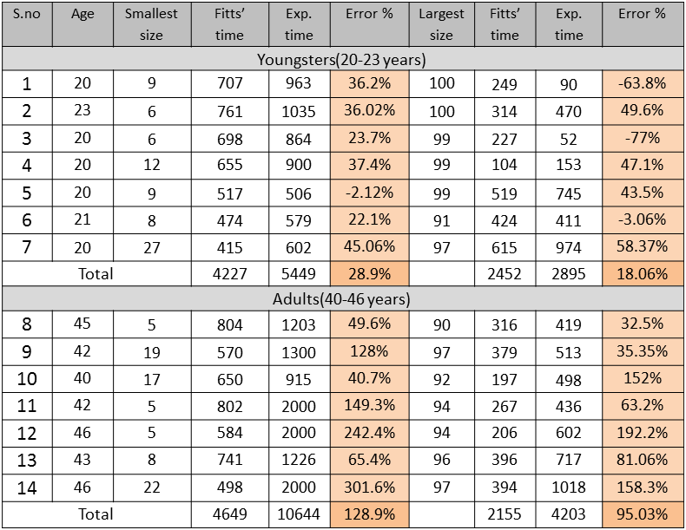
Based on size of the stimulus

Slide 16
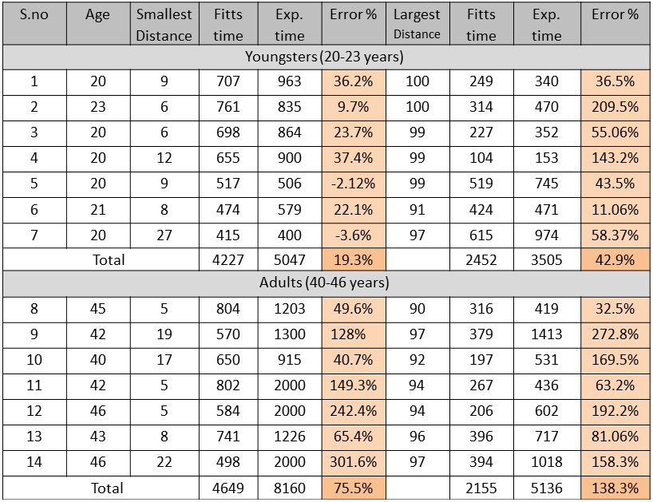
Based on distance of the stimulus

Slide 17
Results
Thus, from our experimental results, we can conclude that the youngsters’ experimental time is more accurate to Fitts’ law time as compared to the adults.
This may be due to quicker reflexes of the youngsters.
Another reason might be that many of the adults might not be regularly using computers but, the youngsters generally use computers on a daily basis.

Slide 18
Target audience plays a key role in design of website.
For adults – Elegant, minimalistic design, bigger and closesly spaced buttons, simple color palette.
For youngsters – Beautiful and captivating design, comfortable placement of buttons, brighter color palette.
This experiment tests the attention and perception of the participants

Slide 19
Conclusion
Finally, we can say that an ideal web page consists of properly spaced buttons, closely knit design, good sizing of the buttons, a comfortable color contrast which also keeps their target audience in mind.

Slide 20
THANK YOU!

